Slide 1

From Noob To Game Developer
Overview Lecture
academy.zariba.com

Slide 2
Lecture Content
The Course
Lecturers
Modules Overview
How to study
What to expect

Slide 3
The Course
Highly competitive course in Game Development.
You do not need any programming knowledge.
You do need some basic computer skills.
By the end you will be able to make your own games and work in the IT industry.
2 times a week from 18:30 to 21:30

Slide 4

Coordinator
Anna Palazova
Ani is a floater. She does it all – administration, finances, HR, business development, etc. Without her, the office would dissolve itself and cease to exist.

Slide 5

Lead Lecturer
Martin Antonov
Co-Founder and CTO at Fractal Games
Graduated Mathematics at the University of Warwick and London School of Economics
Studied one year at the Telerik Software Academy

Slide 6



Lecturers
Plamen
Vasko
Teodor
Teodor and Plamen graduated “From Noob to Game Developer” in January 2016. Vasko currently studies Computer Science at University of London.
Currently they all work at Zariba on various interesting tasks.

Slide 7
Modules Overview
There will be 3 modules
Intro to Programming with Games
OOP, Quality Code and Algorithms
HTML5 and games with Phaser

Slide 8
Modules Overview
There will be 3 extra modules
They will be given in a separate course
Introduction to JavaScript
Making a Game with Phaser and TypeScript
Introduction to Unity3D and Algorithms

Slide 9

Modules Overview
Intro to Programming with Games
1. Introduction to Programming
2. Primitive Data Types
3. Operators and Expressions
4. Console Input Output
5. Conditional statements
6. Loops
7. Arrays
8. Multidimensional arrays
9. Strings
10. Methods
11. Introduction to Classes and Objects
12. Creating Console Games – Hangman + 2 More Games

Slide 10
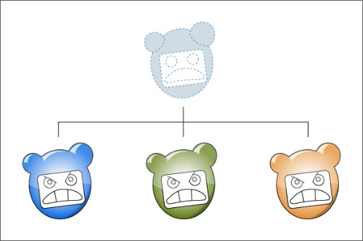
Modules Overview
OOP, Quality Code and Algorithms
Course Introduction
Exception Handling
Defining Classes (2 parts)
Extension methods, lambda and LINQ
OOP Principles (2 parts)
Quality Code
Design Patterns
Data Structures
Algorithms Complexity and Sorting
Recursion and Combinatorial Algorithms
Dynamic Programming (Test)
MonoGame XNA Introduction
Creating 1-2 larger games with MonoGame

Slide 11


Modules Overview
Making Games with Phaser and TypeScript
Course Introduction
Intro to HTML, CSS and JavaScript
JavaScript OOP and TypeScript
Phaser Games x2
Bonus Lecture

Slide 12

Modules Overview
Evaluation
Introduction to Programming with Games
20% Homework
40% Teamwork Project
40% Exam (Game)
OOP, Quality Code & Algorithms
10% Homework
30% Test
60% Teamwork Project
Phaser
100% Teamwork Project
To successfully complete the course:
You must not skip lectures
You must present your homework on time
You must participate in teamwork projects
You must do well on the exam

Slide 13

How to study
Do your homework
Participate in lectures
Ask questions
Watch the videos online
Participate in teamwork
USE GOOGLE!

Slide 14
Timeline
6-7 months
2 times a week from 18:30 to ~21:30

Slide 15
What to expect
Upon successful completion of the course:
You will know the basics of C#, OOP, Quality Code and Algorithms
You will have made/seen 10+ Games
You will have sufficient experience to work as a Game Developer and sufficient experience to work as a Junior Developer
You will receive a certificate of completion with an overall grade

Slide 16



Zariba Academy
Questions

